Slide 1
Wheatland Trails to the Bow Committee
Shelley McEachern
Chairperson
Notes:
• This committee is comprised of residents from: Carseland, Speargrass & the Surrounding area
• Who want to create run/walk/cycle pathways linking Carseland to Speargrass and Johnson's Island

Slide 2
Community Engagement
Fall of 2019
Residents from Carseland and Speargrass began brainstorming what we felt our communities were lacking and how to align them closer together
Pathway
The consensus was a walk, run, bike pathway physically linking Carseland and Speargrass, as well as, taking advantage of our natural environment and linking together Johnson’s Island
Formed a Society
Authenticated
As COVID waned a group of residents from our two communities and surrounding rural area, applied to the Societies Act and formed “Wheatland Trails to the Bow Committee”
A town hall meeting was held: March 16, 2023 at Carseland Community Hall. Everyone in attendance from both hamlets and surrounding area unanimously agreed to proceeding with this project
Notes:
• Started talking about pathway in Fall of 2019
• We formed Society In 2023 we registered with the Societies Act and incorporated our name "Wheatland Trails to the Bow"
• A Town Hall meeting was held in the Spring and everyone in attendance was in favor or pursuing the pathways

Slide 3
Original Proposed Pathway Route
Phase 1 $540,000.00
Phase II
$550,000.00
Phase III
$810,000.00
Phase IV
$370,000.00
Total Cost
$2,275,000.00
Notes:
• Originally proposed 4 Phases
• Phase 1: from Carseland to Johnson's Island at a cost of $540,000.00
• Phase 2: from Speargrass to Johnson's Island at a cost of $550,000.00
• Phase 3: from Carseland to Speargrass at a cost of $810,000.00
• Phase 4: from Speargrass to the River at a cost of $370,000.00
• For a Total Cost of $2,275,000.000

Slide 4
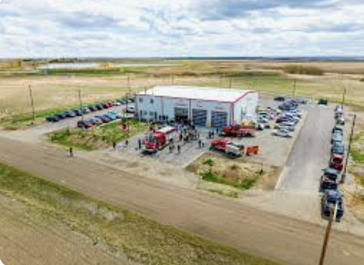
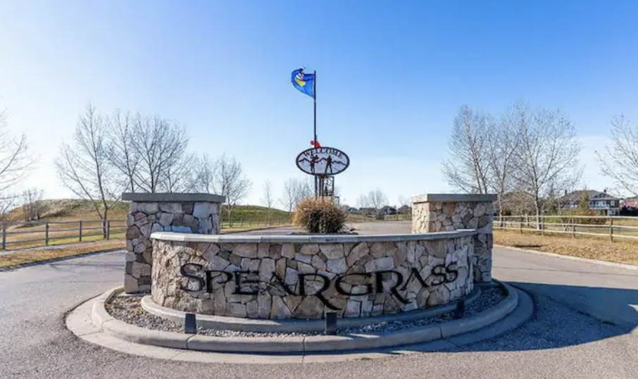
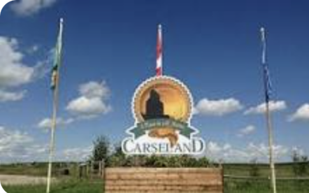
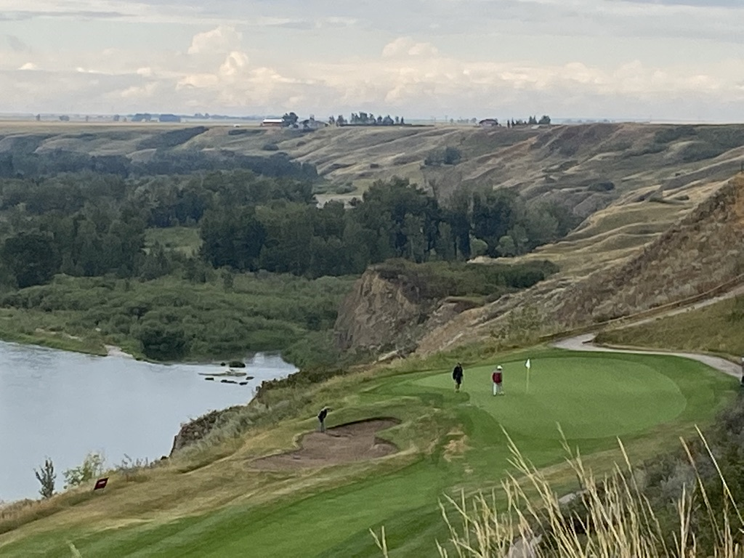
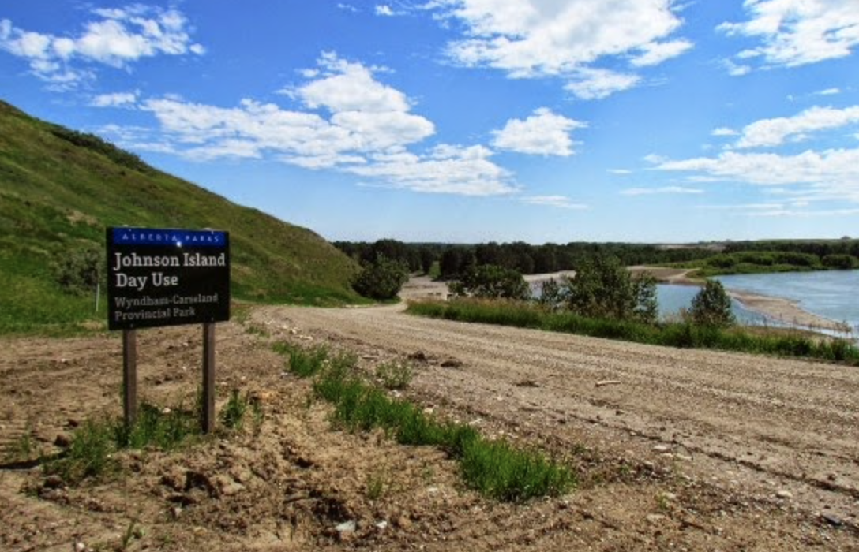
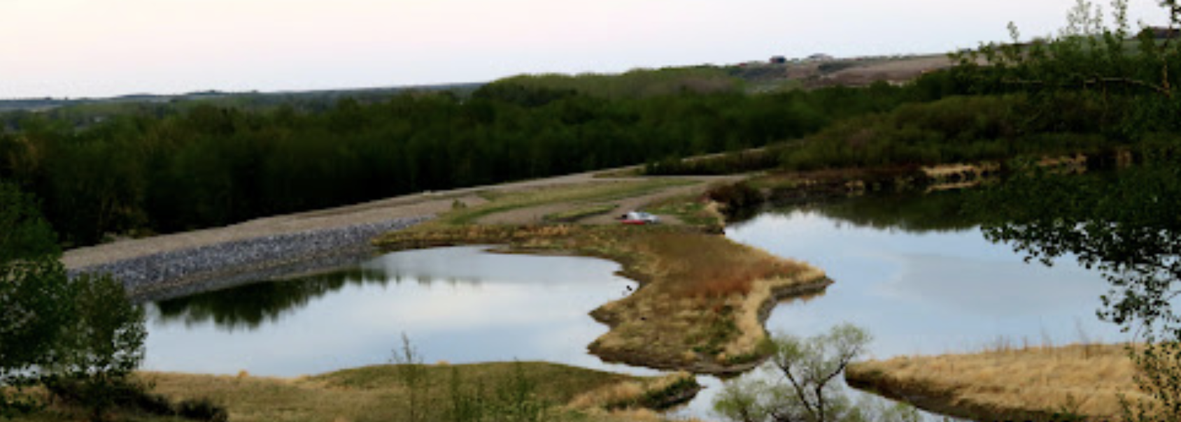
Alternative Route Linking Carseland to Speargrass and Johnson Island
Phase I
Phase II
Range Road 260
Notes:
• This 4 Phase Pathway has increased in cost over $600,000.00 in just 2 years
• Due to rising costs we went back to the drawing board and came up with a more cost effective alternate proposal - with ONLY 2 Phases
• Carseland - Speargrass and Johnson's Island

Slide 5
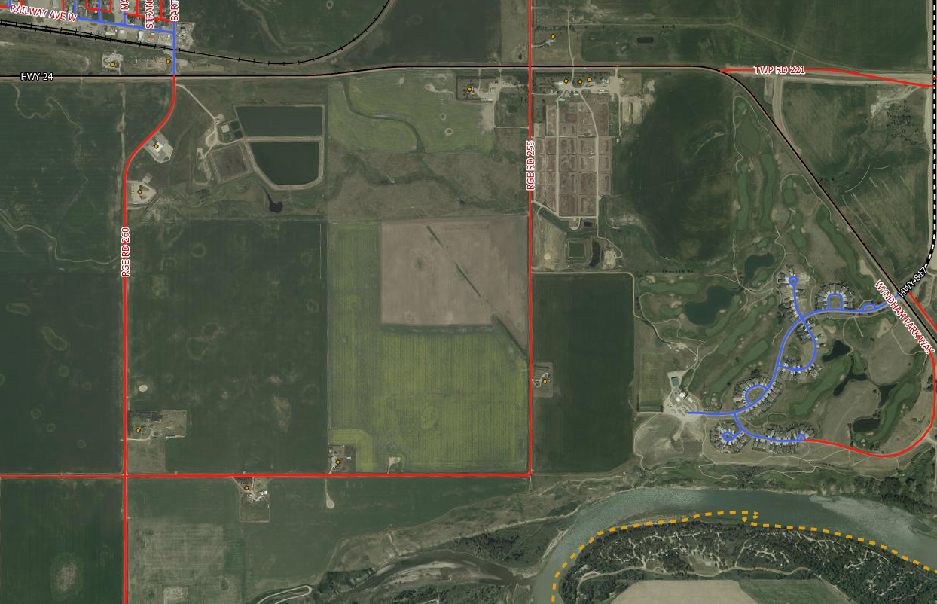
Current Proposed Pathway(s)
Phase 1 Pathway
Phase 1 Pathway
Phase 1 Pathway
Phase II Pathway
Phase II Pathway
Notes:
• From the Ariel view of this diagram, the blue line depicts the proposed new route
• Phase 1 - will run southeast from the Fire Hall along the fence lines and tertiary roads to the north end of the Golf Course and come down to the ridge
• Phase 2 - will follow along the top of the ridge at Speargrass to the top of Johnson's Island

Slide 6
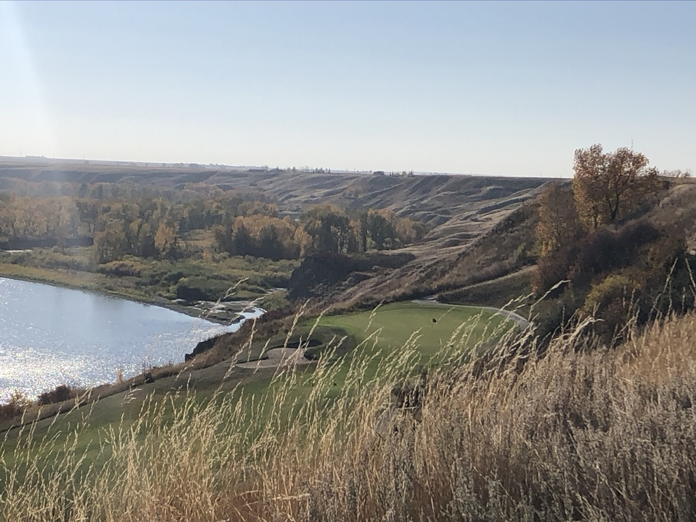
Phase I
to
Phase I - $690, 000.00 (based on 2.5 meters wide asphalt)
Approximately 3.2 km
​
Speargrass
Carseland Fire Hall
Met with management of Speargrass Golf Course and they are very eager to help us develop a pathway in alignment with their golf course development plans
Park at Fire Hall and walk south east
Challenges: 1) We will need approval from Whealtland County if the pathway encroaches beside Range Roads. 2) Will require easements from landowners and the Speargrass Golf Course; everyone we have spoken with to date is open to the idea
Notes:
Phase 1 from Carseland to Speargrass - will cost $690,000.00 and is 3.2 km long
• To date we have met with one landowner and the Golf Course and one has said no
• Speargrass has suggested many ways in which they thought they could help us

Slide 7
Phase II
to
Phase II - $550, 000.00 (based on 2.5 meters wide asphalt)
2.5 km
​
Speargrass
Johnson Island Ridge
Make use of the existing 18th hole cart path; then walk west towards Johnson Island along the top of ridge
Conclude at the top of ridge for Johnson Island
Challenges: We wiil need approval from Alberta Parks as some of the Pathway would encroach on Parks land. The pathway will not extend down to Johnson Island due to the grades as it would be too costly.
Notes:
• Phase 2 will run from Speargrass and conclude at the top of Johnson's Island; which is approximately 2.5 km long
• We will not extend the path down, into Johnson's Island, as it would be too expensive, due to the steep incline
• The cost for Phase II is $550,000.00

Slide 8
By Creating Direct Route(s)
Phase 1 (Alternate)
via Roadways
Phase 1
Carseland to Speargrass
Range Road 260
Phase 2
Speargrass to Johnson’s Island
Will save over a $1,000,000.00
Notes:
• By Creating a more direct route
• We will save 1 million dollars

Slide 9
Funding Breakdown
Total Estimated Cost of Project
Phase I & Phase II
1,240,000.00
$995,000.00
Government Funding & Grants
Grants
Government funding, as well as, healthy living grants are available
Fundraising
$145,000.00
Fundraising
Campaign to adopt a bench, plaque, km marker or granite sign with a “Fun Fact”
$100,000
Angel Donations
From local industries whose employees will benefit from the pathway: Stella- Jones; Nutrien; Orica, Pioneer and CGC
Notes:
• The total cost of Phase I & Phase II would be $1,240,000,000
• We believe we can raise almost a million dollar through Government Funding and Grants. We have presented this concept to Wheatland County and are waiting for approval
• If Wheatland gives us the County's Aggregate Fund; then we can apply to the provincial government to match it
• An additional $145,000,00 would be raised through local fundraising campaigns like adopting a: bench, stone marker; or a plaque
• Lastly we will seek $100,000.00 through Angel Donations of Corporate Sponsorship

Slide 10
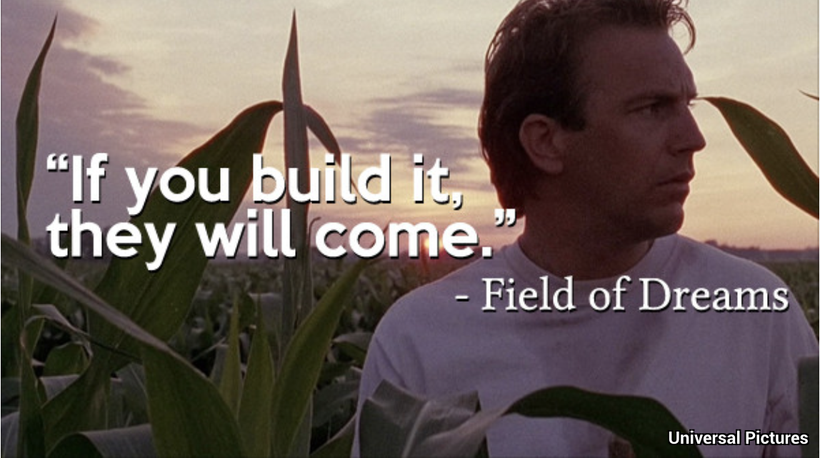
Field of Dreams
Creating Desirability
Walk/Run/Bike
Pathways are standard amenities to modern residential development(s) in every town and city
A pathway will enable residents living in: Carseland, Speargrass and the surrounding rural area to adopt a healthier lifestyle
Our Pathway will be Rich in History
Telling a Story of:
First Nations Peoples, Legacy Pioneer Families,
Local Businesses & Corporate Industries
Notes:
• Walking trails are integral parts of new communities because they attract home buyers
• We want to build a path similar to the one between Black Diamond and Turner Valley; which they call the "Friendship Trail"
• It's like a Field of Dreams If you build it they will come
• It amazes me how rich in History the Carseland/Speargrass area is

Slide 11
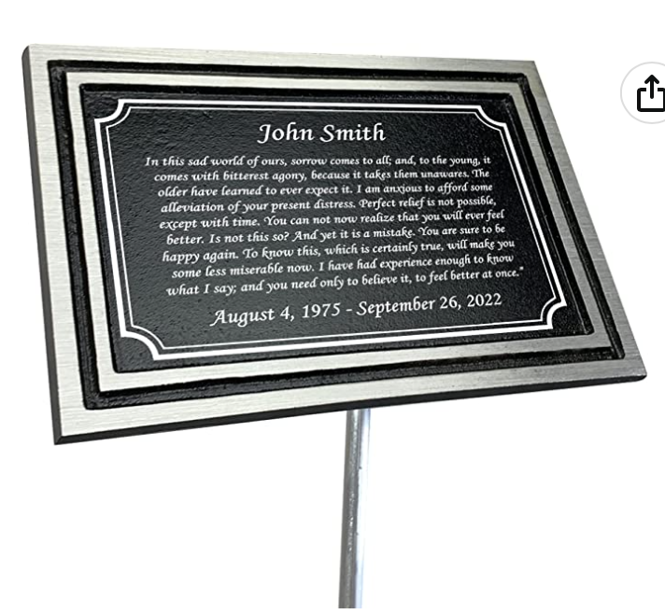
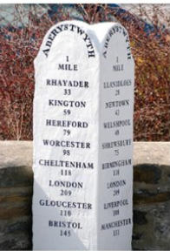
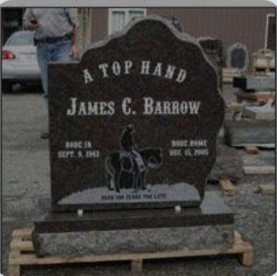
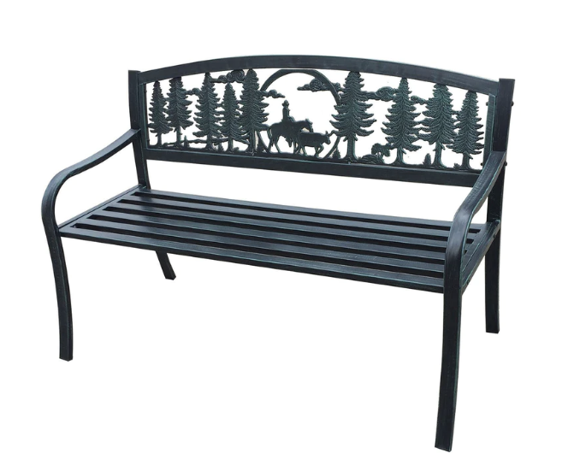
Fundraising & Angel Donations Will tell a Story of the Canadian West With a Fun Fact
They will remind the path users of: our legacy pioneer families, first nations people on treaty 7 land, local businesses and
today’s industry’s leaders. Our focus will be on eco friendly, like minded companies, who believe in environmental innovations.
Various levels of sponsorship will be available so everyone can get involved:
- KM Markers can be purchased by groups or individuals
- Benches with a plaque can sponsored
- Stone markers or metal plaques or can be sponsored
with a fun fact.
- Markers will be placed along the trail in both directions
to keep the pathway users engaged
Notes:
• Our fundraising focus will be by telling "Fun Facts" about : our legacy pioneers; first nations people, local businesses and innovative corporations
• Various levels of sponsorship will be available
• You can sponsor your name on a mile marker; adopt a bench, a metal plaque or a granite marker
• Markers will be placed on both sides of the pathway to keep all users engaged

Slide 12
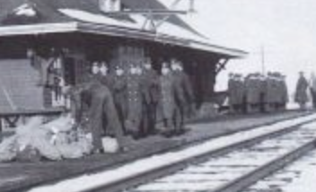
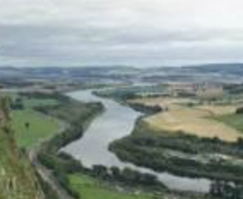
Fundraising Fun Facts
The Naming of Carseland
Carseland is said to be named by Scottish railroad men who were romanticizing their home so far away
Carse (Kars) is defined as – low fertile land usually along a river
Our Mission
Is to create synergy between: residents' of Carseland; Speargrass the surrounding rural areas; as well as, honour our First Nations people; Centennial pioneers; local businesses and corporate sponsors
1881
Major-General Thomas Bland Strange
The first resident of Carseland
(Land presently owned by the Thiessen’s)
Nutrien
Fertilizer significantly increases the amount of food that can be safely grown per acre. The environment has always been a key focus of Nutrien.
Water is cleaned and reused to minimize the amount removed from the river
1914
CPR transported men across Canada so they could join in World War I
Notes:
• Our mission will be to create New Synergies between people living and working in our communities
through "Fundraising Facts" like:
• What year did the first resident settle in Carseland?
• How Carseland Got Its Name?
Carse is defined in the dictionary as low fertile land usually along a river • Bottom left corner the famous "Carse of Gowrie" in Angus, Scotland/ & The Right is Speargrass
• Or how Nutrien Cleans the water they remove from the Bow River and reusing it again
• In 1914 the first train over the rails was to transport young me to war

Slide 13
Three -year Action Plan
Present Project to Wheatland County Council for approval
Once (June) permissions are received we can designate a route
Apply for Incorporation Wheatland Trails to the Bow Committee
Meet with Landowners for any easements for preferred route
Apply for Approval Alberta Transportation and Alberta Parks
Meeting with community members status fundraising/grant writing corporate sponsorship etc., Fundraising Phase 1
Re-Engage with 2 hamlets for community approval Carseland/Speargrass Town Hall Meeting
Met with Speargrass Golf Course and a land owner re proposed pathway
Tender quotes for Phase 1 & Phase II of Pathway
Upon approval we will begin our fundraising initiatives
Fundraising Phase 1
2023
Jan
Feb
Mar
Apr
May
Jun
Jul
Aug
Sept
Oct
Nov
Dec
Fundraising Phase I
Fundraising Phase I
Start Construction Phase 1 of Pathway
Completion of Phase 1 Pathway
Fundraising Phase 1
Fundraising Phase 1
Fundraising Phase 1
Fundraising Phase II
Fundraising Phase 1
2024
Jan
Feb
Mar
Apr
May
Jun
Jul
Aug
Sept
Oct
Nov
Dec
Notes:
• We have a 3 year action plan to complete our project
• Upon receiving Council's approval we will start securing easements for the pathway and secure funding
• We hope to have shovels in the ground for Phase 1 by September 2024 and complete this phase by November 2024

Slide 14
Three -year Action Plan
Fundraising Phase II
Fundraising Phase II
Fundraising Phase II
Fundraising Phase II
Start Construction Phase II of Pathway
Construction Phase II Pathway
Fundraising Phase II
Fundraising Phase II
Completion Phase II Pathway
Fundraising Phase II
2025
Jan
Feb
Mar
Apr
May
Jun
Jul
Aug
Sept
Oct
Nov
Dec
Start Construction Phase II Pathway
Fundraising Phase II
Fundraising Phase II
Construction Phase II Pathway
Finish Phase II Pathway
Fundraising Phase II
2026
6 Month
Contingency
Plan
Jan
Feb
Mar
Apr
May
Jun
Notes:
• We will continue fundraising in 2025 and plan to start Phase II by September of 2025 completing it by November 2025
• A 6 month contingency plan has been incorporated in case we run into any delays

Slide 15
Wheatland Trails to the Bow
Wheatland County resident’s who live in the area excited new industry is developing around us.
We believe that new industry will only attract more new industry
As residents we want to take part in helping make our communities more desirable place(s) to live and play
We are surrounded by a natural beautiful environment; one in which we can create educational pathways, telling the story of our rich history
All while creating a healthy lifestyle for our area residents
Notes:
• Unlike the early Pioneers we do not just
depend on the Bow River for survival
• The river significantly contributes to our 21st Century attitude of living a healthier lifestyle . . . whether: fishing, swimming or going for a walk and enjoying nature
• With new industry moving into the County hopefully it will attract more home buyers
• As resident's it is important for us to help make our communities more attractive places to live
• DEVELOPED walking paths and a Community park just to name a few things
• Now there is more we can do

Slide 16
Volunteers
We all bring unique gifts to the table through life’s experiences:
This is an exciting project and you can help!
Whether it is: - Applying for Grants or Sponsorship - Calling or Writing Letters for Appointments - Research and Costing of Fund Raising Makers - Researching “Fund Raising Facts - Surveying and Advising Best Route to Take – Or just talking to people about our project
Notes:
• We all bring something to the table
• This is a huge project and everyone has something they can contribute
• "WE" the resident's have already accomplished so much in Speargrass like beautifying our front entrance and Greenspaces with: Flags, flowers, trees, planters, pergola, benches; we DEVELOPED walking paths and a Community park just to name a few things
• A walk/run/path is in our best interest: emotionally, physically and financially
• We need your help - so please volunteer

Slide 17
Summary
By building a physical pathway between our two hamlets (Carseland and Speargrass) it will physically align us and allow Wheatland County residents to live a healthier lifestyle
Pathways attract home buyers who enjoy physical exercise and the outdoors
Industry will benefit from their employees ability to exercise on over their lunch breaks; thus lowering their healthcare costs
Wheatland County will benefit from more residents moving into W C. area rather than other county’s
The pathway will honour all those that came before us; it will help educate our children in the way of the indigenous people, legacy pioneers, local businesses and today’s innovative corporations
If you would like to help please contact:
Shelley McEachern
Chairperson, Wheatland Trails to the Bow Committee
(403)934-5665
Shelley.mceach168@gmail.com
Notes:
• In summary we know that living a healthier lifestyle - will help us live longer
• Exercise is not only good for our physical health but our mental health
• By walking the Carse we will be reminded of those who came before us
• We can enjoy the beauty that surrounds us
• And learn, who shares the land with us

